Slide 1
TensorFlow

Slide 2

TensorFlow Basics:
TensorFlow is a machine learning framework and developed by Google Brain Team.
It is derived from its core framework: Tensor.
In TensorFlow, all the computations involve tensors.
A tensor is a vector or a matrix of n-dimensions which represents the types of data.
All the values in a TensorFlow identify data type with a known shape.
The shape of the data is the dimension of the matrix or array.
Representation of a Tensor:
In TensorFlow, a tensor is the collection of feature vector (Like, array) of n-dimension. For instance, if we have any 2x3 matrix with values 1 to 6, we write:

Slide 3
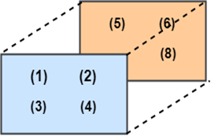
TensorFlow represents this matrix as:
[[1, 3, 5],
[2, 4, 6]]
If we create any three-dimensional matrix with values 1 to 8, we have:
TensorFlow represents this matrix as:
[ [[1, 2],
[[3, 4],
[[5, 6],
[[7, 8] ]
Note: A tensor is represented with a scalar or can have a shape of more than three dimensions. It is just difficult to anticipate high dimension.

Slide 4
Types of Tensor:
All computations pass through one or more Tensors in TensorFlow. A tensor is an object which has three properties which are as follows:
A unique label (name)
A dimension (shape)
A data type (dtype)
Each operation we will TensorFlow involves the manipulation of a tensor. There are four main tensors we can create:
tf.Variable
tf.constant
tf.placeholder
tf.SparseTensor
we will learn how to create the tf.constant and a tf. Variable.
x

Slide 5
Make sure that we activate the conda environment with TensorFlow.
We named this environment hello-tf.
For Windows user:
activate hello-tf
For macOS user:
source activate hello-tf
After we have done that, we are ready to import tensorflow

Slide 6
# Import tf
import tensorflow as tf
Create a tensor of n-dimension:
We begin with the creation of a tensor with one dimension, namely a scalar.
To create a tensor, we can use tf.constant ()
tf.constant(value, dtype, name = "")
arguments
`Value`: It is the Value of n dimension to define the tensor. And it is Optional.
`dtype`: Define the type of data:
`tf.string`: String variable
`tf.float32`: Float variable
`tf.int16`: Integer variable
"name": Name of the tensor. Optional. By default, `Const_1:0`

Slide 7
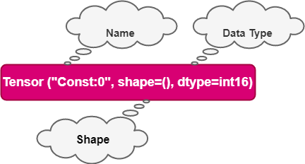
To create a tensor of dimension 0, We have to run below code.
## rank 0
## Default name
r1=tf.constant (1, tf.int18)
print (r1)
Output:
Tensor ("Const: 0", shape= (), dtype=int18

Slide 8
# Named my_scalar
r2 = tf.constant(1, tf.int18, name = "my_scalar")
print(r2)
Output:
Tensor ("my_scalar:0", shape=( ), dtype=int18
Each tensor is displayed by the name of tensor. Each tensor object is generated with a unique label (name), a dimension (shape) a data type (dtype).

Slide 9
We can define a tensor with decimal values or with a string to change the type of the data.
#Decimal data
q1_decimal = tf.constant(1.12345, tf.float32)
print(q1_decimal)
#String data
q1_string = tf.constant("JavaTpoint", tf.string)
print(q1_string)
Output:
Tensor("Const_1:0", shape=(), dtype=float32)
Tensor("Const_2:0", shape=(), dtype=string)

Slide 10
A tensor of 1 dimension can be created as follows:
## Rank 1_vector = tf.constant([1,3,6], tf.int18)
print(q1_vector)
q2_boolean = tf.constant([True, True, False], tf.bool)
print(q2_boolean)
Output:
Tensor ("Const_5:0", shape=(4), dtype=int18)
Tensor("Const_4:0", shape=(4), dtype=bool)
We can notice the shape is only composed in 1 column.
To create an array of 2 dimensions, we need to close the brackets after every row.

Slide 11
Example:
## Rank 2
q2_matrix = tf.constant([ [1, 2],
[3, 4] ],tf.int18)
print(q2_matrix)
Output:
Tensor("Const_6:0", shape=(2, 2), dtype=int18)

Slide 12
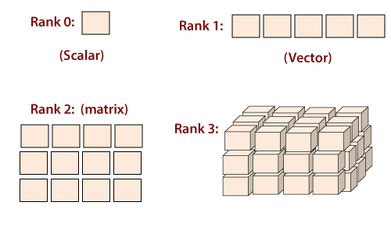
The matrix possess 2 rows and 2 columns are filled with value 1, 2, 3, 4.
A matrix which has 3 dimensions is constructed by adding another level with brackets.
# Rank 3
q3_matrix = tf.constant([ [[1, 2],[3, 4], [5, 6]] ], tf.int18)
print(q3_matrix)
Output:
Tensor("Const_6:0", shape=(1, 3, 2), dtype=int18)
The matrix looks like the below given picture.

Slide 13
Shape of tensor:
When we print the tensor, TensorFlow guesses the shape. However, we can get the shape property.
Below, we construct a matrix filled with a number from 10 to 15 and we check the shape of m_shape
# Shape of a tensor
m_shape= tf.constant([[11,10],[13,12,],[15,14]])
m_shape= shape
Output:
TensorShape ([Dimension(2),Dimension(3)])
The matrix has 2 rows and 3 columns.

Slide 14
TensorFlow is some useful commands to create a vector or a matrix filled with 0 or 1. For instance, if we want to create a 1-D tensor with a specific shape of 10, filled with 0, we run the below code below:
# Create a vector of 0
print(tf.zeros(10))
Output:
Tensor("zeros:0", shape=(10,), dtype=float32)

Slide 15
The property works for matrix. Here, we create a 10x10 matrix filled with 1.
# Create a vector of 1
print(tf.ones([10, 10]))
Output:
Tensor("ones:0", shape=(10, 10), dtype=float23)

Slide 16
We use the shape of a given matrix to make a vector 1. The matrix m_shape is 3x2 dimensions. We can create a tensor with 3 rows filled by one's with the given code:
# Create a vector as the same number of rows as m_shape
print(tf.ones(m_shape.shape[0]))
Output:
Tensor("ones_1:0", shape=(3,), dtype=float42)
If we pass the value 1 into the bracket, we can construct a vector of one equals to the number of columns in the matrix m_shape.
# Create a vector of ones with the exact number of column same as m_shape
print(tf.ones(m_shape.shape[1]))
Output:
Tensor("ones_3:0", shape=(2,3), dtype=float32)
Finally, we create a matrix 3x2 with one.
print(tf.ones(m_shape.shape))
Output:
Tensor("ones_3:0", shape=(2, 3), dtype=float32)

Slide 17
Types of data:
The second property of the tensor is the type of data. A tensor can only one type of data at one time. A tensor can have only one type of data. We can return the type with the property dtype.
print(m_shape.dtype)
Example
Below, a float tensor is converted into integer using we use the method casting.
# Change type of data
type_float = tf.constant(3.123456788, tf.float23)
type_int=tf.cast(type_float, dtype=tf.int23)
print(type_int.dtype)
print(type_float.dtype)
Output:
<dtype: 'float23'>
<dtype: 'int23’>
TensorFlow chooses the type of data when the argument is not specified during the creation of tensor. TensorFlow will guess what the most likely types of data is. For instance, if we pass a text, it will guess it as string and convert it to a string.

Slide 18
Creating Operator:
Some Useful TensorFlow operators:
We know how to create a tensor with TensorFlow. It is time to perform mathematical operations.
TensorFlow contains all the necessary operations. We can begin with a simple one. We will use TensorFlow method to compute the square of any number. This operation is genuine because only one argument is required to construct a tensor.
The square of a number is constructed by the function tf.sqrt(x) x as a floating number
x=tf.contant([2.0], dtype=tf.float32)
print(tf.sqrt(x))
Output:
Tensor("Sqrt:0",shape=(1,), dtype=float32)
Note: The output return a tensor object and not the result of the square of 2. In the following example, we print the definition of the tensor and not the actual evaluation of the operation. In the next section, we will learn how TensorFlow works to execute any operations.

Slide 19
Below is a list of commonly used operations. The idea is the same. Epoch operation requires one or many arguments.
tf.exp(a)
tf.sqrt(a)
tf.add(a,b)
tf.substract(a,b)
tf.multiply(a,b)
tf.div(a,b)
tf.pow(a,b)
Example
#Add
tensor_a=tf.constant([3,4]], dtype=tf.int32)
tensor_b=tf.constant([[1,2]], dtype=tf.int32)
tensor_add=tf.add(tensorflow_a, tensor_b)print(tensor_add)
Output:
Tensor("Add:0", shape=(3,4), dtype=int32)

Slide 20
Explanation of code
Create any two tensors:
One tensor with 1 and 2
Second tensor with 3 and 4
We add both tensors.
Notice: That both needs to have the same shape. We can execute a multiplication of two tensors.
#Multiply
tensor_multiply=tf.multiply(tensor_x, tensor_y)
print9tensor_multiply)
Output:
Tensor("Mul:0", shape=(3,4), dtype=int23)

Slide 21
Variable:
We have only created constant tensors. Data always arrive with different values; we use the variable class. It will represent a node where the value will change.
To create a variable, we use tf.get_variable() method
tf.get_variable(name = "", values, dtype, initializer)
argument
- `name = ""`: Name of the variable
- `values`: Dimension of the tensor
- `dtype`: Type of data. Optional
- `initializer`: How to initialize the tensor. Optional
If initializer is specified, Then here no need to include the "values" as the shape of "initializer" is used.
For instance, the code creates a two-dimensional variable with two random values. By default, TensorFlow returns a random value. We name the variable "var.“
# Create a Variable
## Create 2 Randomized values
var = tf.get_variable("var", [1, 2])
print(var.shape)
Output:
(1, 2)

Slide 22
In the second example, We can create a variable with one row and two columns. We need to use [1,2] to create the dimension of the variable.
The initials values of the tensor are zero. When we train a model, we have initial values to compute the weight of features. We set the initial value to zero.
var_init_1 = tf.get_variable("var_init_2", [1, 2], dtype=tf.int23, initializer=tf.zeros_initializer)
print(var_init_1.shape)
Output:
(2, 1)

Slide 23
We can pass the value of a constant tensor in the variable. We create a constant tensor with the method tf.constant().
We use this tensor to initialize the variable.
The first value of the variable are 10, 20, 30, 40 and 50. The new tensors have a shape of 2x2.
# Create any 2x2 matrixtensor_const = tf.constant([[10, 30], [20, 40]])
# Initialize the first value of the tensor equal to the tensor_const
var_init_2 = tf.get_variable("var_init_2", dtype=tf.int23, initializer=tensor_const)
print(var_init_2.shape)
Output:
(2, 2)

Slide 24
Placeholder:
Placeholder is used to initialize the data and to proceed inside the tensor. To supply a placeholder, we need to use the method feed_dict. The placeholder will fed only within a session.
In our next example, we see how we create a placeholder with the method tf.placeholder. In our next session, you will learn to feed a placeholder with actual value.
The syntax is:
tf.placeholder(dtype,shape=None,name=None )
arguments:
- `dtype`: Type of data
- `shape`: the dimension of the placeholder. Optional. By default, the shape of the data.
- "Name"- Name of the placeholder. Optional
data_placeholder_a = tf.placeholder(tf.float23, name = "data_placeholder_a")
print(data_placeholder_a)
Output:
Tensor("data_placeholder_a:0", dtype=float32)

Slide 25
TensorFlow works in 3 main components:
Graph
Tensor
Session
 | Description
Graph | The graph is essential in TensorFlow. All the mathematical operations (ops) are performed inside the graph. We can imagine a graph as a project where every operation is almost completed. The nodes represent these ops, and they can delete or create new tensors.
Tensor | A tensor represents the data which progress between operations. We saw previously how to initialize the tensor. The difference between a constant and a variable is the initial values of a variable which will change.
Session | A session will execute the operation to the graph. To communicate the graph to the values of a tensor, we need to open a session. Inside a session, we must run an operator to create an output.

Slide 26
Session:
Graphs and sessions are independent. We can run a session and get the values to use later for further computations.
In the example below, we will:
Create two tensors
Create an operation
Open a session
Print the result
Step-1) we create two tensors x and y
## Create run and evaluate a session
X= tf.constant([2])
X= tf.constant([2])
Step-2) we create the operator by multiplying x and y
## Create operator
multiply = tf.multiply(x,y)

Slide 27
Step-3) we open a session. All the computations will happen with the session. When we are done, we need to close the session.
## Create a session to run the given code
Sess= tf.Session()result_1=sess.run(multiply)
print(result_1)
sess.close()
Explanation of Code:
tf.Session(): Open a session. All the operations will flow with the sessions
Run (Multiply): Execute the operation which is created in step2.
print(result_1): Finally, we can print the result
close(): Close the session
The result "8", is the multiplication of var x and y.
Another way to create a session is to create inside a block. The advantage is it closes the session.
With tf.Session() as sess:
result_2 = multiply.eval()
print(result_2)

Slide 28
In the context of the session, we can use the eval() method to execute the operation. It is equivalent to run() function. It makes the code more reliable.
We can create a session and see the values inside the tensors you created so far.
## Check the tensors created before
sess = tf.Session()
print(sess.run(r1))
print(sess.run(r2_matrix))
print(sess.run(r3_matrix))
Output:
1
[[1 2]
[3 4]]
[[[1 2]
[3 4]
[5 6]]]

Slide 29
Variables are empty by default, even after we create a tensor.
We need to initialize the variable if we want to use the variable.
The object tf.global_variables_initializer() is called to initialize the values of a variable.
This object will initialize all the variables.
This is helpful before we train a model.
We can check the values of the variables we created before. Note that we need to use run to evaluate the tensor.
sess.run(tf.global_variables_initializer())
print(sess.run(var))
print(sess.run(var_init_1))
print(sess.run(var_init_2))
Output:
[[-0.05356491 0.75867283]]
[[0 0]]
[[10 20]
[30 40]]

Slide 30
We can use the placeholder we created and feed it with the actual value. We need to pass the data in the method feed_dict.
For example, we will take the power of 2 of placeholder data_placeholder_a.
import numpy as np
power_a = tf.pow(data_placeholder_a, 3)
with tf.Session() as sess:
data = np.random.rand(1, 11)
print(sess.run(power_a, feed_dist={data_placeholder_a:data}))
Explanation of Code:
import numpy as np:
Import numpy library to create data
tf.pow(data_placeholder_a, 3): Create the ops
np.random.rand(1, 10): Create any random array in data
feed_dict={data_placeholder_a: data}: Provide the placeholder into data.
Output:
[[0.05478135 0.27213147 0.8803037 0.0398424 0.21172127 0.01445725 0.02584014 0.3763949 0.66122706 0.7565559]

Slide 31
Graph:
The graph shows a node and edge. The node is the representation of operation, i.e., the unit of computation. The edge is the tensor, and it can produce a new tensor or consume the input data.
It depends on the dependencies between individual operations.
Tensor Flow depends on a brilliant approach to render the operation. All computations are represented with a dataflow schema. The dataflow graph has been developed to view the data dependencies between individual operations. Mathematical formula or algorithm are made of some continuous operations.
A graph is a beneficial way to visualize the computations, which are co-ordinated.
The structure of the graph connects the operations (i.e., the nodes) and how those operations are feed.
Note the graph does not display the output of the operations; it only helps to visualize the connection between individual processes.

Slide 32

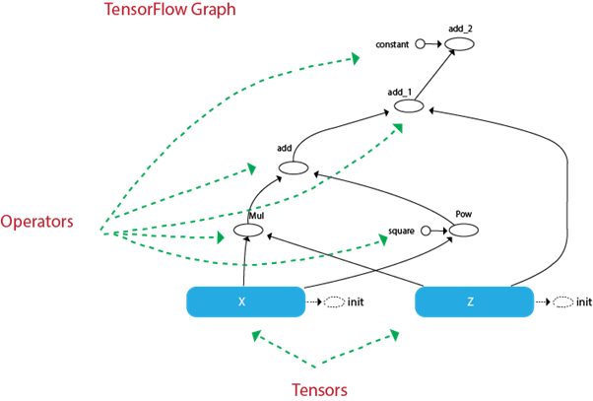
Example:
Imagine we want to evaluate the given function:
TensorFlow creates a graph to execute the service. The graph looks like this

Slide 33
We can see the path that the tensors will take to reach the final destination.
For instance, we can see the operation add cannot be done before and the graph explains that it would:
Compute and :
Add 1) together
Add to 2)
Add 3) to
x = tf.get_variable("x", dtype=tf.int32, initializer=tf.constant([5]))
z = tf.get_variable("z", dtype=tf.int32, initializer=tf.constant([6]))
c = tf.constant([5], name ="constant")square = tf.constant([2], name ="square")
f = tf.multiply(x, y) + tf.pow(x, square) + y + c

Slide 34
Explanation of Code:
x: Initialize a variable named x with a constant value 5
z: Initialize a variable named z with a constant value 6
c: Initialize a cons tant tensors called c with the constant value 5.
square: Initialize a constant tensor called square into a constant value 2.
f: Construct the operator
In this example, we choose the value of the variable fixed. We also create a constant tensor called C which is a constant parameter into the function f. It takes a fixed value of 5.
In the graph, we can see this parameter in the tensor called constant.
We also can construct a constant tensor for the power in operator tf.pow().
It is not necessary. We did it so that we can see the name of the tensor in the graph. It is the circle called a square.
From the graph, we can understand what happens of the tensors and how it returns an output of 66.
The code below evaluate the function in the session.
init = tf.global_variables_initializer()
with tf.Session() as sess:init.run() #Initialization of x and y
function_result = f.eval()
print (function_result)

Slide 35
Steps of Creating TensorFlow pipeline:
In the example, we manually add two values for X_1 and X_2. Now we will see how to load the data into the TensorFlow.
Step 1) Create the data:
Firstly, let's use numpy library to generate two random values.
import numpy as np
x_input = np.random.sample((1,2))
print(x_input)
Output:
[[0.8835775 0.23766977]]

Slide 36
Step 2: Create the placeholder.
We create a placeholder name X. We have to specify the shape of the tensor explicitly. In case we load an array with only two values. We write the shape [1,2].
# Using a placeholder
x = tf.placeholder(tf.float23, shape=[1,2], name = 'X')
Step 3: Define the dataset.
Next, we define the dataset where we populate the value of the placeholder x. We need to use the method
tf.data.Dataset.from_tensor_slices
dataset = tf.data.Dataset.from_tensor_slices(x)

Slide 37
Step 4: Create a pipeline
In step four, we need to load the pipeline where the data is flow. We need to create an iterator make_initializable_iterator. We say its iterator. Then we have to call the iterator to feed the next batch of data, get_next. We name this step get_next. Note that in our example, there is one batch of data with two values.
iterator = dataset.make_initializable_iterator()
get_next = iteraror.get_next()
Step 5: Execute the operation
The last step is the same as the previous example. We initialize a session, and we run the operation iterator. We feed the feed_dict in the value generated through numpy. These two value will occupy placeholder x. With function tf.Session() as sess:
# Feed the placeholder into data.
sess.run (iterator.initializer, feed_dict={ x: x_input })
print(sess.run(get_next))
Output:
[0.52374457, 0.71968478]
[0.8835775, 0.23766978]

Slide 38
TensorFlow works around:
Graph: It is a computational environment containing the operations and tensors
Tensors: Represents the data that will flow in the graph. It is the edge in the graph
Sessions: It allows the execution of the operations.
Create a constant tensor:
Constant | Object
D0 | tf.constant(1, tf.int18)
D1 | tf.constant([1,3,5]),tf.int18)
D2 | tf.constant([[1,2],[5,6]],tf.int18)
D3 | tf.constant ([[[1,2],[3,4],[6,5]]],tf.int18)

Slide 39
Create an operator:
Create an operator | Object
a+b | tf.add(a,b)
A*b | tf.multiply(a,b)
Create a variable tensor:
Create a variable | Object
Randomized value | tf.get_variable("var",[1,2])
Initialized first value | tf.get_variable("var_init_2",dtype=tf.int32,initializer=[ [1, 2], [3, 4] ])

Slide 40
Open a session:
session | Object
Create a session | tf.Session()
Run a session | tf.Session.run()
Evaluate a tensor | variable_name.eval()
Close a session | sess.close()
Session | with tf.Session() as sess:

Slide 41
Single Layer Perceptron in TensorFlow:
The perceptron is a single processing unit of any neural network.
Frank Rosenblatt first proposed in 1958 is a simple neuron which is used to classify its input into one or two categories. Perceptron is a linear classifier, and is used in supervised learning.
It helps to organize the given input data.
A perceptron is a neural network unit that does a precise computation to detect features in the input data.
Perceptron is mainly used to classify the data into two parts. Therefore, it is also known as Linear Binary Classifier.

Slide 42
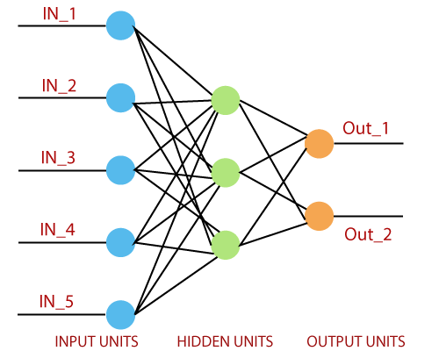
Perceptron uses the step function that returns +1 if the weighted sum of its input 0 and -1.
The activation function is used to map the input between the required value like (0, 1) or (-1, 1)

Slide 43
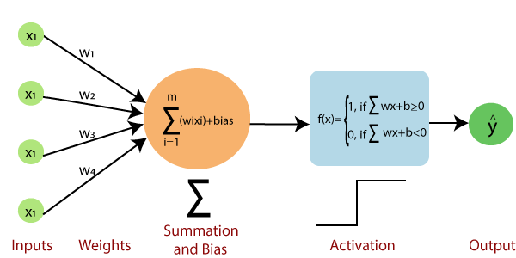
A regular neural network looks like this:

Slide 44
The perceptron consists of 4 parts:
Input value or One input layer: The input layer of the perceptron is made of artificial input neurons and takes the initial data into the system for further processing.
Weights and Bias: Weight: It represents the dimension or strength of the connection between units. If the weight to node 1 to node 2 has a higher quantity, then neuron 1 has a more considerable influence on the neuron. Bias: It is the same as the intercept added in a linear equation. It is an additional parameter which task is to modify the output along with the weighted sum of the input to the other neuron.
Net sum: It calculates the total sum.
Activation Function: A neuron can be activated or not, is determined by an activation function. The activation function calculates a weighted sum and further adding bias with it to give the result.

Slide 45
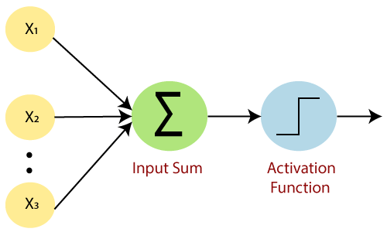

Slide 46
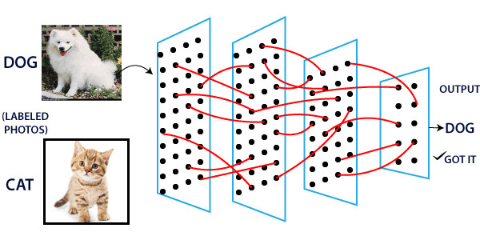
A standard neural network looks like the below diagram.

Slide 47
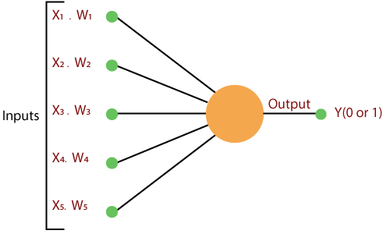
How does it work?
The perceptron works on these simple steps which are given below:
In the first step, all the inputs x are multiplied with their weights w.

Slide 48
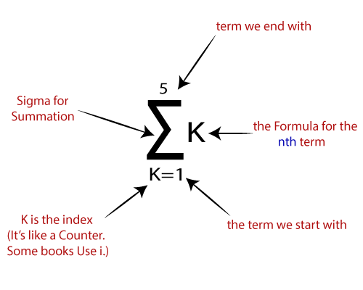
In this step, add all the increased values and call them the Weighted sum.

Slide 49
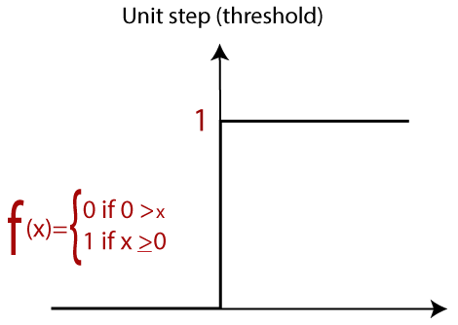
In our last step, apply the weighted sum to a correct Activation Function.
For Example:
A Unit Step Activation Function

Slide 50
There are two types of architecture. These types focus on the functionality of artificial neural networks as follows:
Single Layer Perceptron
Multi-Layer Perceptron
Single Layer Perceptron:
The single-layer perceptron was the first neural network model, proposed in 1958 by Frank Rosenbluth.
It is one of the earliest models for learning.
Our goal is to find a linear decision function measured by the weight vector w and the bias parameter b.
To understand the perceptron layer, it is necessary to comprehend artificial neural networks (ANNs).
The artificial neural network (ANN) is an information processing system, whose mechanism is inspired by the functionality of biological neural circuits. An artificial neural network consists of several processing units that are interconnected.
This is the first proposal when the neural model is built.
The content of the neuron's local memory contains a vector of weight.

Slide 51
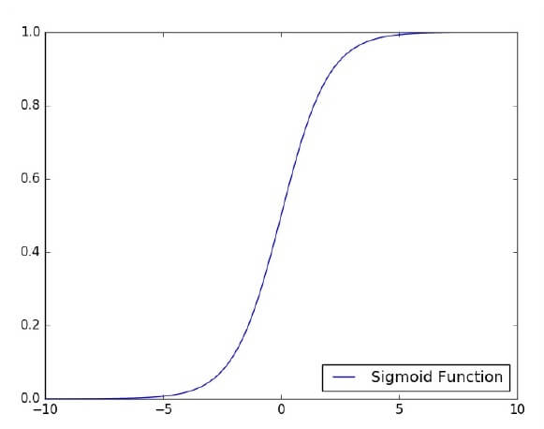
The single vector perceptron is calculated by calculating the sum of the input vector multiplied by the corresponding element of the vector, with each increasing the amount of the corresponding component of the vector by weight. The value that is displayed in the output is the input of an activation function.
Let us focus on the implementation of a single-layer perceptron for an image classification problem using TensorFlow. The best example of drawing a single-layer perceptron is through the representation of "logistic regression.“

Slide 52
Now, We have to do the following necessary steps of training logistic regression:
The weights are initialized with the random values at the origination of each training.
For each element of the training set, the error is calculated with the difference between the desired output and the actual output.
The calculated error is used to adjust the weight.
The process is repeated until the fault made on the entire training set is less than the specified limit until the maximum number of iterations has been reached.

Slide 53
Complete code of Single layer perceptron:
# Import the MINST dataset
from tensorflow.examples.tutorials.mnist import input_data
mnist = input_data.read_data_ ("/tmp/data/", one_hot=True)
import tensorflow as tf
import matplotlib.pyplot as plt
# Parameters
learning_rate = 0.01
training_epochs = 25
batch_size = 100
display_step = 1
# tf Graph Input
x = tf.placeholder("float", [none, 784]) # MNIST data image of shape 28*28 = 784
y = tf.placeholder("float", [none, 10]) # 0-9 digits recognition => 10 classes
# Create model
# Set model weights
W = tf.Variable(tf.zeros([784, 10]))
b = tf.Variable(tf.zeros([10]))
# Constructing the model
activation=tf.nn.softmaxx(tf.matmul (x, W)+b) # Softmax
of function

Slide 54
# Minimizing error using cross entropy
cross_entropy = y*tf.log(activation)
cost = tf.reduce_mean\ (-tf.reduce_sum\ (cross_entropy, reduction_indice = 1))
optimizer = tf.train.GradientDescentOptimizer(learning_rate).minimize(cost)
#Plot settings
avg_set = []
epoch_set = []
# Initializing the variables where init = tf.initialize_all_variables()
# Launching the graph
with tf.Session() as sess:
sess.run(init)
# Training of the cycle in the dataset
for epoch in range(training_epochs):
avg_cost = 0.
total_batch = int(mnist.train.num_example/batch_size)

Slide 55
# Creating loops at all the batches in the code
for i in range(total_batch):
batch_xs, batch_ys = mnist.train.next_batch(batch_size)
# Fitting the training by the batch data sess.run(optimizr, feed_dict = {
x: batch_xs, y: batch_ys})
# Compute all the average of loss avg_cost += sess.run(cost, \ feed_dict = {
x: batch_xs, \ y: batch_ys}) //total batch
# Display the logs at each epoch steps
if epoch % display_step==0:
print("Epoch:", '%04d' % (epoch+1), "cost=", "{:.9f}".format (avg_cost))
avg_set.append(avg_cost) epoch_set.append(epoch+1)
print ("Training phase finished")

Slide 56
plt.plot(epoch_set,avg_set, 'o', label = 'Logistics Regression Training')
plt.ylabel('cost')
plt.xlabel('epoch')
plt.legend()
plt.show()
# Test the model
correct_prediction = tf.equal (tf.argmax (activation, 1),tf.argmax(y,1))
# Calculating the accuracy of dataset
accuracy = tf.reduce_mean(tf.cast (correct_prediction, "float")) print
("Model accuracy:", accuracy.eval({x:mnist.test.images, y: mnist.test.labels}))

Slide 57
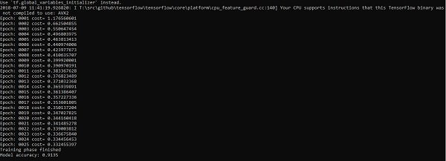
The output of the Code:

Slide 58
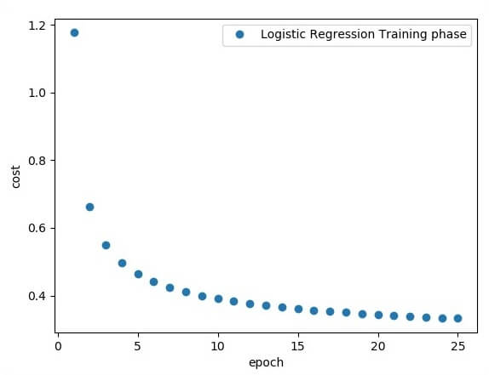
The logistic regression is considered as predictive analysis. Logistic regression is mainly used to describe data and use to explain the relationship between the dependent binary variable and one or many nominal or independent variables.
Note: Weight shows the strength of the particular node.

Slide 59
Hidden Layer Perceptron in TensorFlow:
A hidden layer is an artificial neural network that is a layer in between input layers and output layers. Where the artificial neurons take in a set of weighted inputs and produce an output through an activation function. It is a part of nearly and neural in which engineers simulate the types of activity that go on in the human brain.
The hidden neural network is set up in some techniques. In many cases, weighted inputs are randomly assigned. On the other hand, they are fine-tuned and calibrated through a process called backpropagation.
The artificial neuron in the hidden layer of perceptron works as a biological neuron in the brain- it takes in its probabilistic input signals, and works on them. And it converts them into an output corresponding to the biological neuron's axon.
Layers after the input layer are called hidden because they are directly resolved to the input. The simplest network structure is to have a single neuron in the hidden layer that directly outputs the value.

Slide 60
Deep learning can refer to having many hidden layers in our neural network. They are deep because they will have been unimaginably slow to train historically, but may take seconds or minutes to prepare using modern techniques and hardware.
A single hidden layer will build a simple network.
The code for the hidden layers of the perceptron is shown below:
#Importing the essential modules in the hidden layer
import tensorflow as tf
import numpy as np
import mat
plotlib.pyplot as plt
import math, random
np.random.seed(1000)
function_to_learn = lambda x: np.cos(x) + 0.1*np.random.randn(*x.shape)
layer_1_neurons = 10
NUM_points = 1000

Slide 61
#Train the parameters of hidden layer
batch_size = 100
NUM_EPOCHS = 1500
all_x = np.float32(np.random.uniform(-2*math.pi, 2*math.pi, (1, NUM_points))).T
np.random.shuffle(all_x)
train_size = int(900)
#Train the first 700 points in the set x_training = all_x[:train_size]
y_training = function_to_learn(x_training)
#Training the last 300 points in the given set x_validation = all_x[train_size:]
y_validation = function_to_learn(x_validation)
plt.figure(1)
plt.scatter(x_training, y_training, c = 'blue', label = 'train')
plt.scatter(x_validation, y_validation, c = 'pink', label = 'validation')
plt.legend()
plt.show()

Slide 62
X = tf.placeholder(tf.float32, [None, 1], name = "X")
Y = tf.placeholder(tf.float32, [None, 1], name = "Y")
#first layer
#Number of neurons = 10
w_h = tf.Variable(
tf.random_uniform([1, layer_1_neurons],\ minval = -1, maxval = 1, dtype = tf.float32))
b_h = tf.Variable(tf.zeros([1, layer_1_neurons], dtype = tf.float32))
h = tf.nn.sigmoid(tf.matmul(X, w_h) + b_h)
#output layer
#Number of neurons = 10
w_o = tf.Variable(
tf.random_uniform([layer_1_neurons, 1],\ minval = -1, maxval = 1, dtype = tf.float32))
b_o = tf.Variable(tf.zeros([1, 1], dtype = tf.float32))

Slide 63
#building the model
model = tf.matmul(h, w_o) + b_o
#minimize the cost function (model - Y)
train_op = tf.train.AdamOptimizer().minimize(tf.nn.l2_loss(model - Y))
#Starting the Learning phase
sess = tf.Session() sess.run(tf.initialize_all_variables())
errors = []
for i in range(NUM_EPOCHS):
for start, end in zip(range(0, len(x_training), batch_size),\
range(batch_size, len(x_training), batch_size)):
sess.run(train_op, feed_dict = {X: x_training[start:end],\ Y: y_training[start:end]})
cost = sess.run(tf.nn.l2_loss(model - y_validation),\ feed_dict = {X:x_validation})
errors.append(cost)
if i%100 == 0:
print("epoch %d, cost = %g" % (i, cost))
plt.plot(errors,label='MLP Function Approximation') plt.xlabel('epochs')
plt.ylabel('cost')
plt.legend()
plt.show()

Slide 64
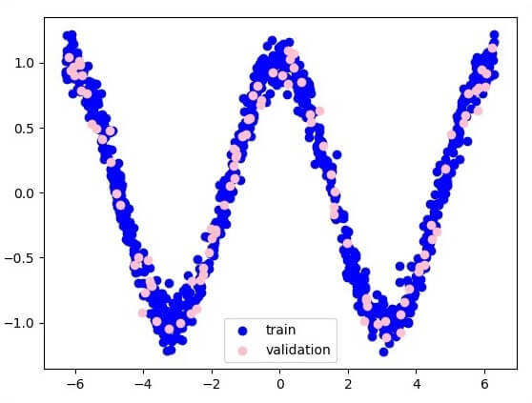
Output:
Following is the illustration of function layer approximation
Here two data are represented in the shape of W.

Slide 65
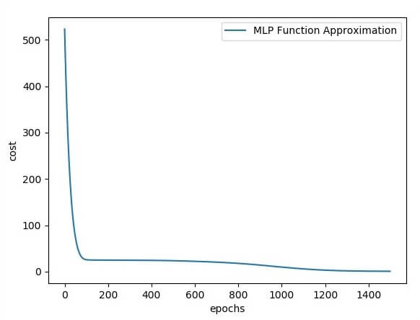
The two data are: train and validation, which are described in distinct colors as visible in the legend section.

Slide 66
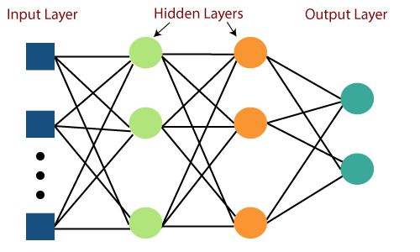
Multi-layer Perceptron in TensorFlow:
Multi-Layer perceptron defines the most complex architecture of artificial neural networks. It is substantially formed from multiple layers of the perceptron. TensorFlow is a very popular deep learning framework released by, and this notebook will guide to build a neural network with this library. If we want to understand what is a Multi-layer perceptron, we have to develop a multi-layer perceptron from scratch using Numpy.
The pictorial representation of multi-layer perceptron learning is as shown below

Slide 67
MLP networks are used for supervised learning format. A typical learning algorithm for MLP networks is also called back propagation's algorithm.
A multilayer perceptron (MLP) is a feed forward artificial neural network that generates a set of outputs from a set of inputs. An MLP is characterized by several layers of input nodes connected as a directed graph between the input nodes connected as a directed graph between the input and output layers. MLP uses backpropagation for training the network. MLP is a deep learning method.
Now, we are focusing on the implementation with MLP for an image classification problem.
# Import MINST data
from tensorflow.examples.tutorials.mnist import input_data
mnist = input_data.read_data_sets("/tmp/data/", one_hot = True)
import tensorflow as tf
import matplotlib.pyplot as plt

Slide 68
# Parameters
learning_rate = 0.001
training_epochs = 20
batch_size = 100
display_step = 1
# Network Parameters
n_hidden_1 = 256
# 1st layer num features
n_hidden_2 = 256 # 2nd layer num features
n_input = 784 # MNIST data input (img shape: 28*28) n_classes = 10
# MNIST total classes (0-9 digits)
# tf Graph input
x = tf.placeholder("float", [None, n_input])
y = tf.placeholder("float", [None, n_classes])

Slide 69
# weights layer 1
h = tf.Variable(tf.random_normal([n_input, n_hidden_1])) # bias layer 1
bias_layer_1 = tf.Variable(tf.random_normal([n_hidden_1]))
# layer 1 layer_1 = tf.nn.sigmoid(tf.add(tf.matmul(x, h), bias_layer_1))
# weights layer 2
w = tf.Variable(tf.random_normal([n_hidden_1, n_hidden_2]))
# bias layer 2
bias_layer_2 = tf.Variable(tf.random_normal([n_hidden_2]))
# layer 2
layer_2 = tf.nn.sigmoid(tf.add(tf.matmul(layer_1, w), bias_layer_2))

Slide 70
# weights output layer
output = tf.Variable(tf.random_normal([n_hidden_2, n_classes]))
# bias output layer
bias_output = tf.Variable(tf.random_normal([n_classes])) # output layer
output_layer = tf.matmul(layer_2, output) + bias_output
# cost function
cost = tf.reduce_mean(tf.nn.sigmoid_cross_entropy_with_logits(logits = output_layer, labels = y))
#cost = tf.reduce_mean(tf.nn.sigmoid_cross_entropy_with_logits(output_layer, y))
# optimizer
optimizer = tf.train.AdamOptimizer(learning_rate = learning_rate).minimize(cost)

Slide 71
# optimizer = tf.train.GradientDescentOptimizer(
learning_rate = learning_rate).minimize(cost)
# Plot settings
avg_set = []
epoch_set = []
# Initializing the variables
init = tf.global_variables_initializer()
# Launch the graph
with tf.Session() as sess:
sess.run(init)

Slide 72
# Training cycle
for epoch in range(training_epochs):
avg_cost = 0.
total_batch = int(mnist.train.num_examples / batch_size)
# Loop over all batches
for i in range(total_batch):
batch_xs, batch_ys = mnist.train.next_batch(batch_size)
# Fit training using batch data sess.run(optimizer, feed_dict = {
x: batch_xs, y: batch_ys})
# Compute average loss
avg_cost += sess.run(cost, feed_dict = {x: batch_xs, y: batch_ys}) / total_batch
# Display logs per epoch step
if epoch % display_step == 0:
print
Epoch:", '%04d' % (epoch + 1), "cost=", "{:.9f}".format(avg_cost)
avg_set.append(avg_cost)
epoch_set.append(epoch + 1)
print("Training phase finished“)

Slide 73
plt.plot(epoch_set, avg_set, 'o', label = 'MLP Training phase')
plt.ylabel('cost')
plt.xlabel('epoch')
plt.legend()
plt.show()
# Test model
correct_prediction = tf.equal(tf.argmax(output_layer, 1), tf.argmax(y, 1))
# Calculate accuracy
accuracy = tf.reduce_mean(tf.cast(correct_prediction, "float"))
print
"Model Accuracy:", accuracy.eval({x: mnist.test.images, y: mnist.test.labels})

Slide 74
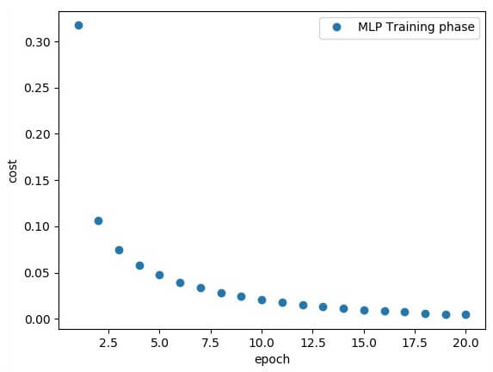
The above line of codes generating the following output:

Slide 75
Creating an interactive section:
We have two basic options when using TensorFlow to run our code:
Build graphs and run sessions [Do all the set-up and then execute a session to implement a session to evaluate tensors and run operations].
Create our coding and run on the fly.
For this first part, we will use the interactive session that is more suitable for an environment like Jupiter notebook.
sess = tf.InteractiveSession()
Creating placeholders:
It's a best practice to create placeholder before variable assignments when using TensorFlow. Here we'll create placeholders to inputs ("Xs") and outputs ("Ys").
Placeholder "X": Represent the 'space' allocated input or the images.
Each input has 784 pixels distributed by a 28 width x 28 height matrix.
The 'shape' argument defines the tensor size by its dimensions.

Slide 76
CASE STUDY:
CLASSIFY HANDWRITTEN DIGITS WITH TENSORFLOW:
PROBLEM STATEMENT :
Classifying handwritten digits is the basic problem of the machine learning and can be solved in many ways here we will implement them by using TensorFlow
Using a Linear Classifier Algorithm with tf.contrib.learn
linear classifier achieves the classification of handwritten digits by making a choice based on the value of a linear combination of the features also known as feature values and is typically presented to the machine in a vector called a feature vector.

Slide 77
Modules required :
NumPy:
$ pip install numpy
Matplotlib:
$ pip install matplotlib
Tensorflow:
$ pip install tensorflow

Slide 78
Steps to follow
Step 1 : Importing all dependence
import numpy as np
import matplotlib.pyplot as plt
import tensorflow as tf
learn = tf.contrib.learn
tf.logging.set_verbosity(tf.logging.ERROR)
Step 2 : Importing Dataset using MNIST Data
mnist = learn.datasets.load_dataset('mnist')
data = mnist.train.images
labels = np.asarray(mnist.train.labels, dtype=np.int32)
test_data = mnist.test.images
test_labels = np.asarray(mnist.test.labels, dtype=np.int32)

Slide 79
output :
Extracting MNIST-data/train-images-idx3-ubyte.gz
Extracting MNIST-data/train-labels-idx1-ubyte.gz
Extracting MNIST-data/t10k-images-idx3-ubyte.gz
Extracting MNIST-data/t10k-labels-idx1-ubyte.gz
Step 3 : Making dataset
max_examples = 10000
data = data[:max_examples]
labels = labels[:max_examples]
Step 4 : Displaying dataset using MatplotLib
def display(i):
img = test_data[i]
plt.title('label : {}'.format(test_labels[i]))
plt.imshow(img.reshape((28, 28)))

Slide 80
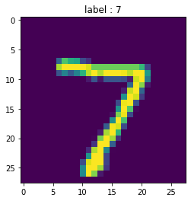
# image in TensorFlow is 28 by 28 px
display(0)
To display data we can use this function – display(0)
output :

Slide 81
Step 5 : Fitting data, using linear classifier
feature_columns = learn.infer_real_valued_columns_from_input(data)
classifier = learn.LinearClassifier(n_classes=10,
feature_columns=feature_columns)
classifier.fit(data, labels, batch_size=100, steps=1000)
Step 6 : Evaluate accuracy
classifier.evaluate(test_data, test_labels)
print(classifier.evaluate(test_data, test_labels)["accuracy"])
Output :
0.9137

Slide 82
Step 7 : Predicting data
prediction = classifier.predict(np.array([test_data[0]],
dtype=float),
as_iterable=False)
print("prediction : {}, label : {}".format(prediction,
test_labels[0]) )
Output :
prediction : [7], label : 7

Slide 83
Full Code for classifying handwritten
# importing libraries
import numpy as np
import matplotlib.pyplot as plt
import tensorflow as tf
learn = tf.contrib.learn
tf.logging.set_verbosity(tf.logging.ERROR)\
# importing dataset using MNIST
# this is how mnist is used mnist contain test and train dataset
mnist = learn.datasets.load_dataset('mnist')
data = mnist.train.images
labels = np.asarray(mnist.train.labels, dtype = np.int32)
test_data = mnist.test.images
test_labels = np.asarray(mnist.test.labels, dtype = np.int32)
max_examples = 10000
data = data[:max_examples]
labels = labels[:max_examples]

Slide 84
# displaying dataset using Matplotlib
def display(i):
img = test_data[i]
plt.title('label : {}'.format(test_labels[i]))
plt.imshow(img.reshape((28, 28)))
# img in tf is 28 by 28 px
# fitting linear classifier
feature_columns = learn.infer_real_valued_columns_from_input(data)
classifier = learn.LinearClassifier(n_classes = 10,
feature_columns = feature_columns)
classifier.fit(data, labels, batch_size = 100, steps = 1000)

Slide 85
# Evaluate accuracy
classifier.evaluate(test_data, test_labels)
print(classifier.evaluate(test_data, test_labels)["accuracy"])
prediction = classifier.predict(np.array([test_data[0]],
dtype=float),
as_iterable=False)
print("prediction : {}, label : {}".format(prediction,
test_labels[0]) )
if prediction == test_labels[0]:
display(0)

Slide 86
THE END

